Slide 1
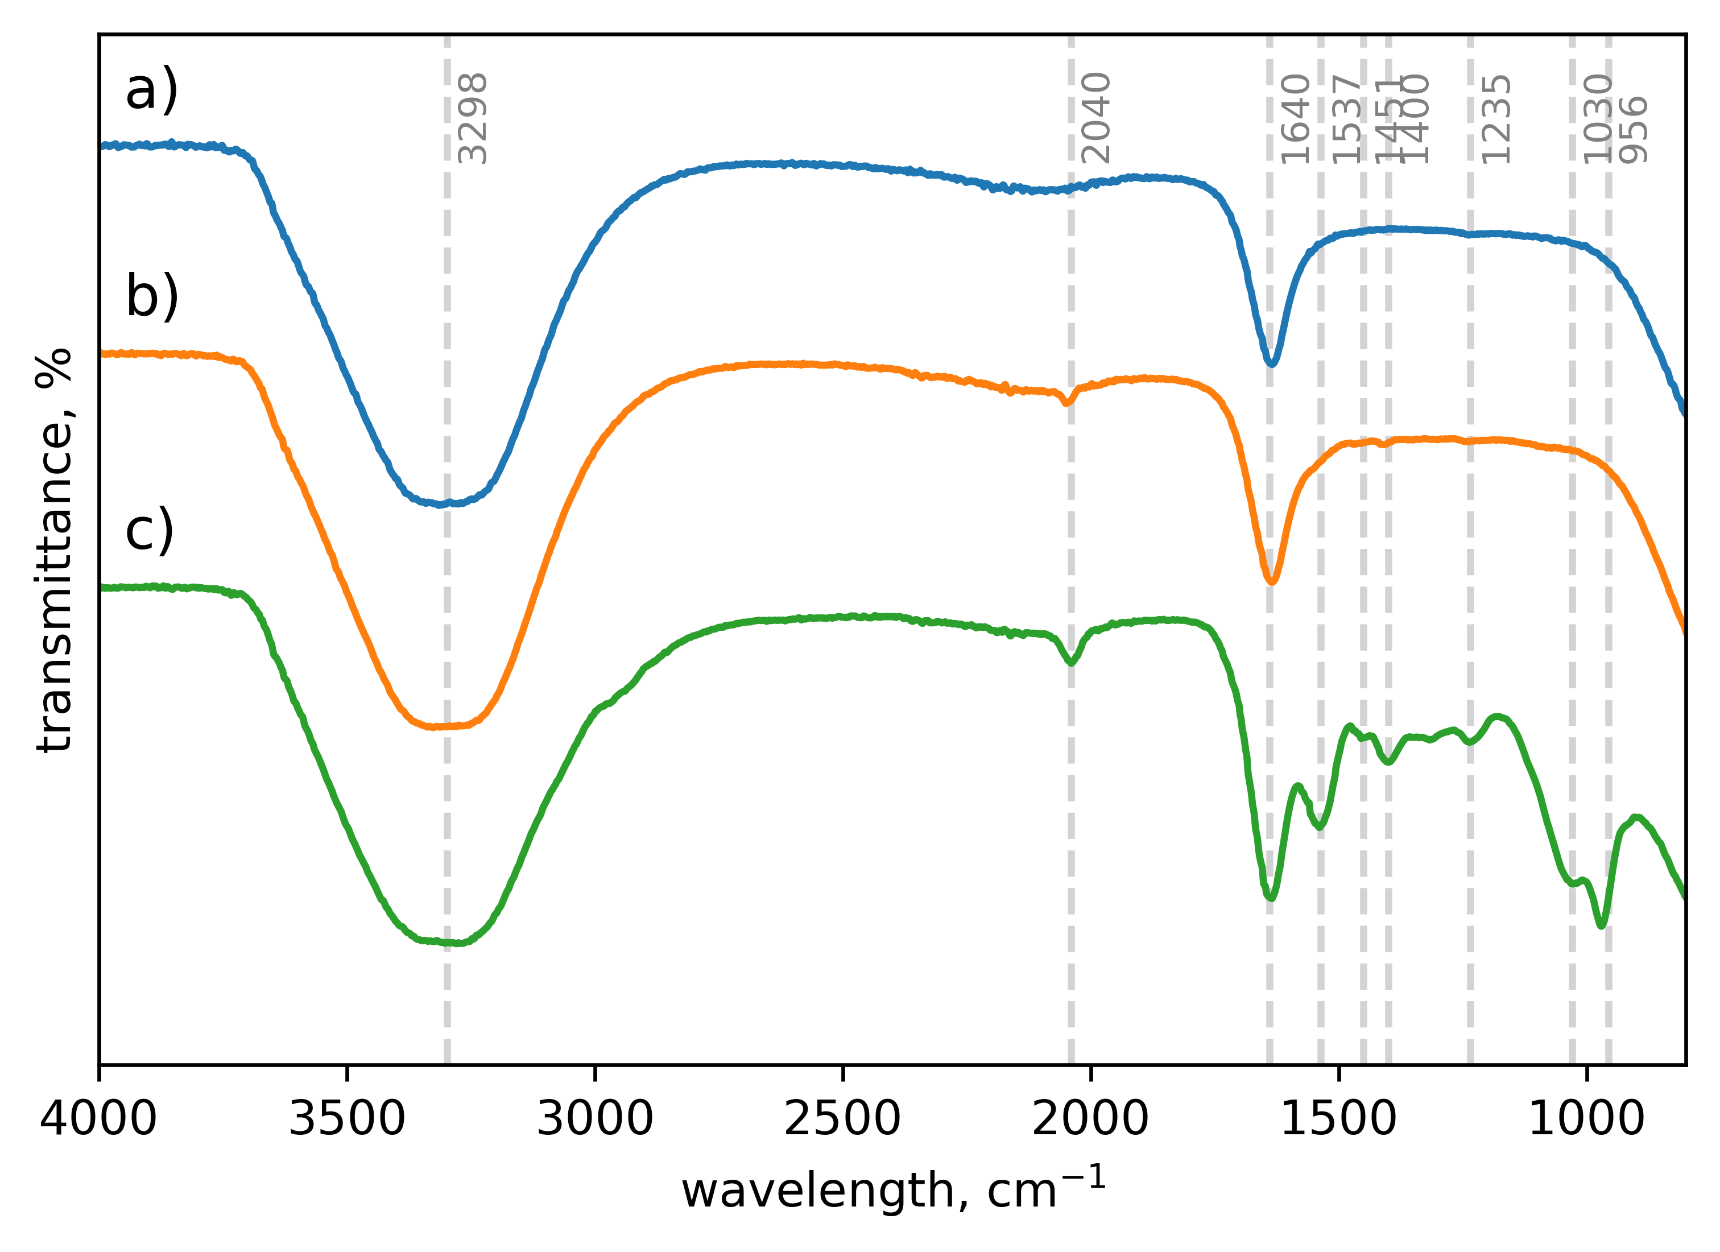
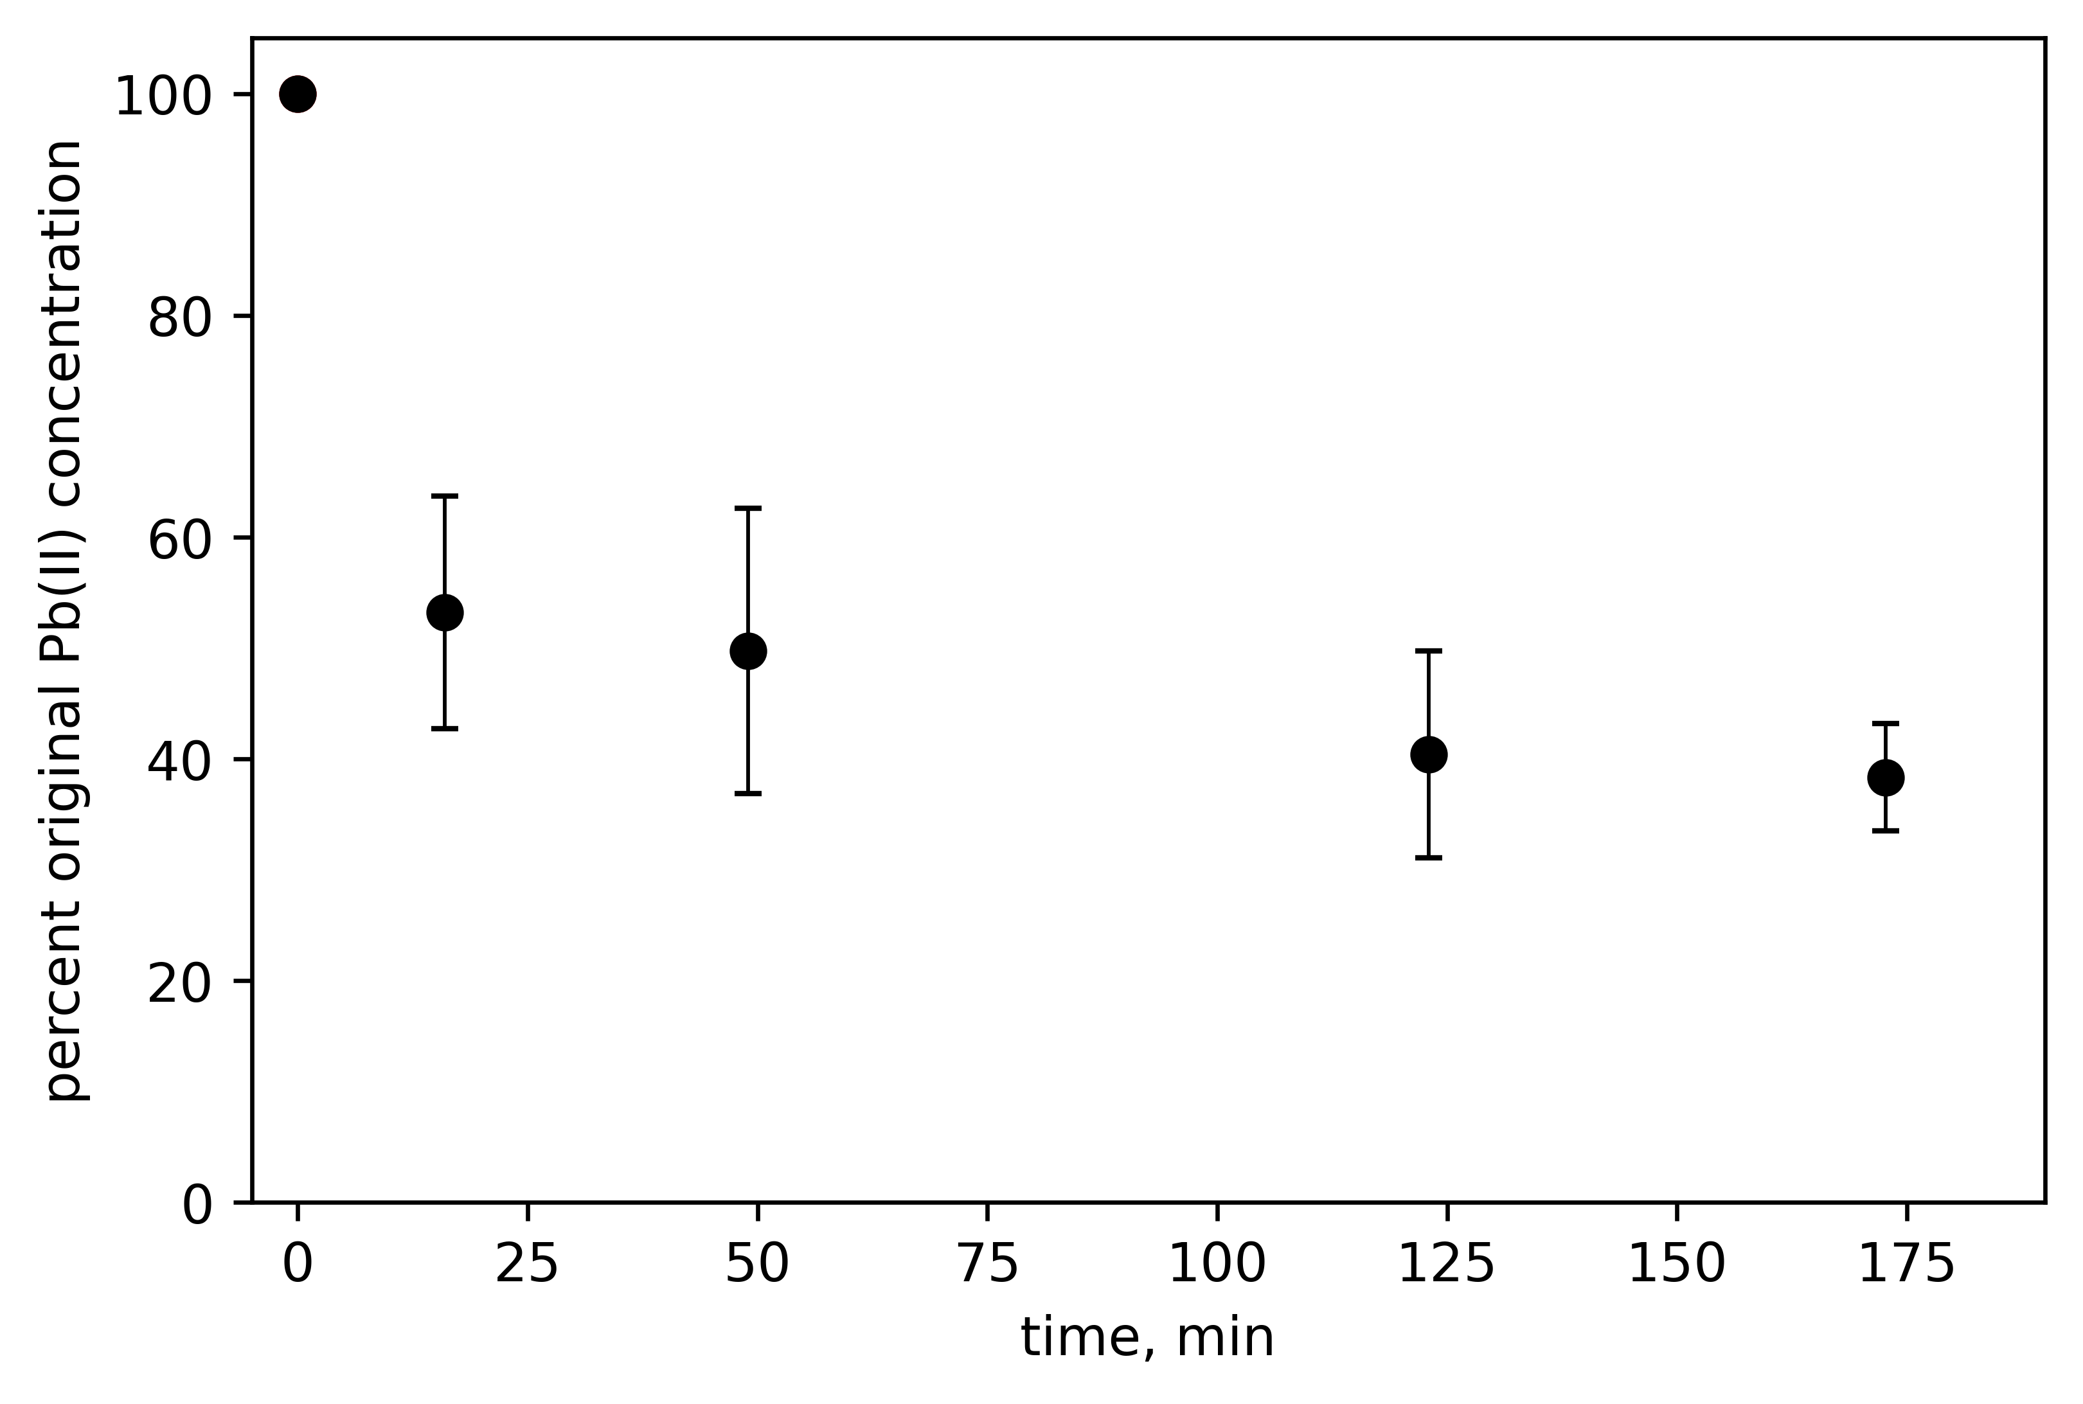



Microbial Pb(II) precipitation: the role of biosorption as a Pb(II) removal mechanism
Brandon van Veenhuyzen, Hendrik G. Brink, Evans M.N. Chirwa
deon.brink@up.ac.za
INTRODUCTION
An industrially obtained consortium (IOC) of bacteria precipitates hazardous Pb(II) as PbS and Pb(0).
Dead bacteria has been widely studied as biomass for passive Pb(II) removal by adsorption (biosorption).
OBJECTIVE
Inhibit metabolic activity of IOC without damaging cell structure.
Investigate potential metabolically independent mechanism of Pb removal.
METHOD & MATERIALS
IOC grown in 20 g/L tryptone, 10 g/L yeast extract, 1 g/L NaCl, 0.041 g/L NaNO₃ solution for 24 h.
IOC thereafter exposed to NaN₃ for 3 h.
Dead IOC spiked in various amounts into different concentrations of Pb(II) .
Analytical methods: Aqueous Pb(II) measured with AA spectroscopy, metabolic activity measured with MTT, and surface characterized by FTIR spectroscopy.
RESULTS
Metabolic activity undetected after NaN₃ sterilization.
Damage of cell structure undetected after NaN₃ sterilization (Fig. 1b)
Fig. 1: FTIR spectra of IOC a) after 24 h growth period, b) after 3 h exposure to NaN₃, and c) after exposure to NaN₃ and Pb(NO₃)₂.
Pb(II) removal from solution corresponded with significant changes to cell structure (Fig. 1c), specifically observed as changes in amide, phosphate, and carboxyl groups.
61.7 % of 80 mg/L Pb(II) solution removed after 3 h by NaN₃ sterilized IOC (Fig. 2).
Fig. 2: Percent lead remaining in solution as a function of time after the addition of the NaN₃-sterilized consortium.
Maximum Pb(II) removal was observed at an initial concentration of 125 mg/L Pb(II) for IOC dosed between 25.2 and 47.5 mg/L..
CONCLUSIONS
Pb(II) removal not exclusive to living IOC.
Chemical binding of Pb(II) to cell surface plays a role in Pb(II) removal by dead IOC.
Dead IOC shows potential as an effective material for Pb(II) biosorption.
University of Pretoria
Department of Chemical Engineering
Acknowledgements
National Research Foundation

